Slide 1
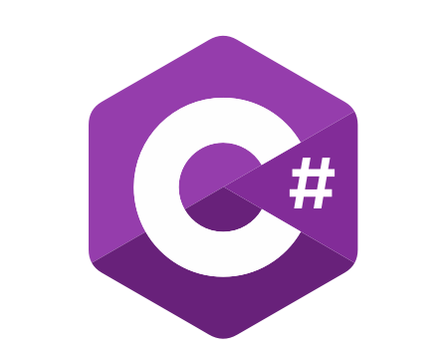
C# OOP
Course Introduction
SoftUni Team
Technical Trainers
Software University
https://softuni.bg/

Slide 2
Table of Contents
Course Objectives
Training and Team
Course Organization
Course Infrastructure
Evaluation Criteria

Slide 3
Have a Question?
sli.do
#csharp-advanced

Slide 4

Course Objectives

Slide 5
Why OOP?
Object-oriented programming is an important paradigm
Anyone involved in software development should be familiar with OOP and OO modelling
All modern languages are either object-oriented or support classes and objects
Modern frameworks, libraries and APIs are object-oriented
OOP is a basic requirement for starting a job as developer

Slide 6
Practical Exam
2 practical problems for 4 hours:
Create a simple project that:
Follows the OOP principles
Implements functionality based on a description
Test a provided class
Automated judge system with real-time feedback
Upload a zip project to the judge system

Slide 7
Theoretical Exam
You will have 30 minutes once you enter
Multiple-choice with 1 or more correct answers
English
Automated quiz system
Available online the day before the practical exam
You can submit your answers just one time

Slide 8

The Team

Slide 9
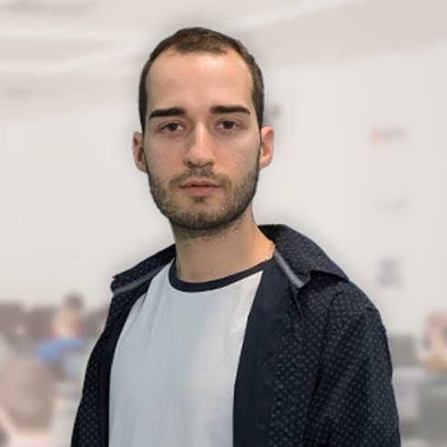
Nikolay Kostov
Solutions Architect @ ZenCodeo
15+ years in the IT
Developer, Manager, Trainer, Architect
Аctive role in the development of the Judge platform - https://judge.softuni.bg/
Microsoft Certified Trainer
Personal blog: nikolay.it

Slide 10
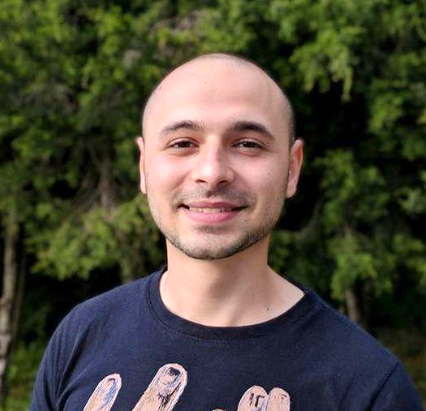
Stoyan Shopov
Team Lead @ SoftUni
Technical Trainer @ SoftUni
ASP.NET Web Developer
Experience with WebForms & WPF
Mountain lover

Slide 11

Course Organization

Slide 12
C# OOP Course - Timeline
28-October-2019
19-December-2019
C# OOP
7 weeks * 4 times / week
15 credits
Start: 28-October-2019
Theoretical Exam: 14-December-2019
Practical Exam: 15-December-2019
Theoretical Exam Retake: 18-December-2019
Practical Exam Retake: 19-December-2019

Slide 13

Homework Assignments & Exercises
Your homework is mainly work in class
Lesson days → slides + live demos + exercises
Exercise days → only exercises
How to submit your homework?
Submitted in the judge system
Do your homework when it's due
Assignments pile up quickly

Slide 14



Scoring System for the Course
Theoretical Exam 5%
PracticalExam 90%
Presence in class 5%
Evaluation
Homework 5 %

Slide 15



Course Web Site, Forum and FB Group
Official web site:
Official discussion forum:
Official Facebook group:
Community Facebook group:
https://softuni.bg/C#OOP-June-2019
https://softuni.bg/forum/categories/30/
https://www.facebook.com/CSharpAdvanced/
https://www.facebook.com/SoftUniCSharpCommunity/

Slide 16
https://softuni.bg/csharp-oop

Slide 17












SoftUni Diamond Partners

Slide 18




SoftUni Organizational Partners

Slide 19




Trainings @ Software University (SoftUni)
Software University - High-Quality Education and Employment Opportunities
softuni.bg
Software University Foundation
http://softuni.foundation/
Software University @ Facebook
facebook.com/SoftwareUniversity
Software University Forums
forum.softuni.bg

Slide 20

License
This course (slides, examples, demos, videos, homework, etc.) is licensed under the "Creative Commons Attribution-NonCommercial-ShareAlike 4.0 International" license

